Slide 1




KYTC/Egis
Appraising the Tough Ones
Charles Watkins, KYTC
Eric Monhollon, KYTC
Kenny Stephenson, Egis
Ken Fleetwood, Egis

Slide 2

Appraisal Process – A General Overview
Receive Plans, Title Work, Legal Descriptions
Complete the “Project Report”
Complete the “Comparable Sales Book” : 3-Month Average
Contact property owners
Analyze and complete Appraisal
Review Appraisal
Approved for making offer
This Photo by Unknown Author is licensed under CC BY
9-Month Average

Slide 3
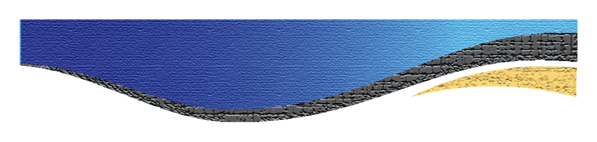
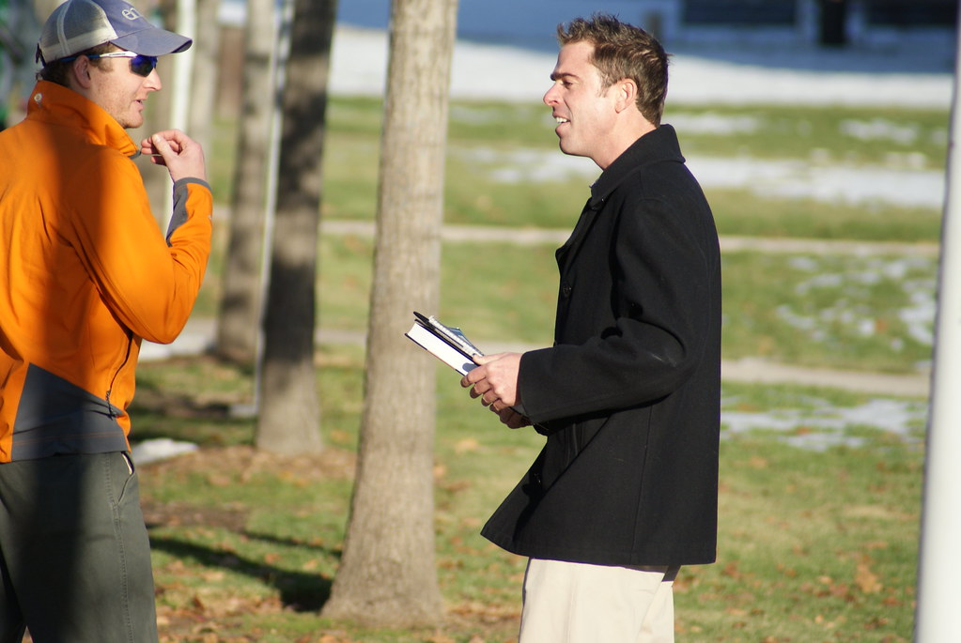
OWNER CONTACT – IMPORTANCE & APPROACH
Required by Federal Guidelines
Our Approach – Meet Due Diligence
- Letter
- Phone Call
- Door Knock
- Document Your Attempts
> Note these in Appraisal
This Photo by Unknown Author is licensed under CC BY

Slide 4

APPRAISAL EXAMPLES – SIMPLE TO COMPLEX

Slide 5
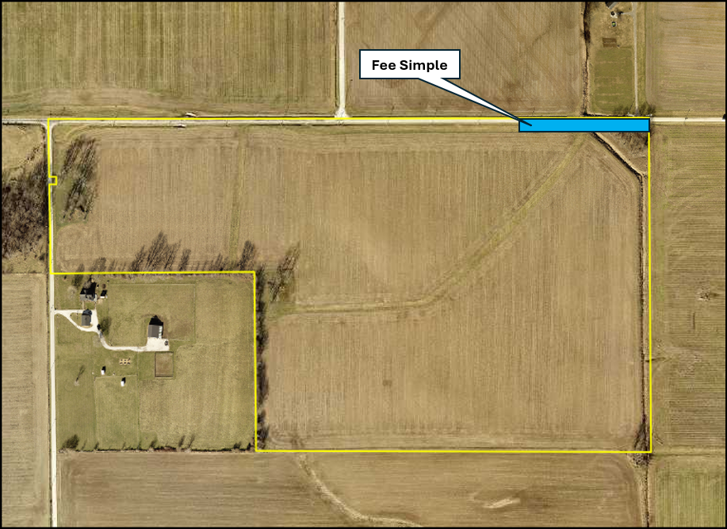
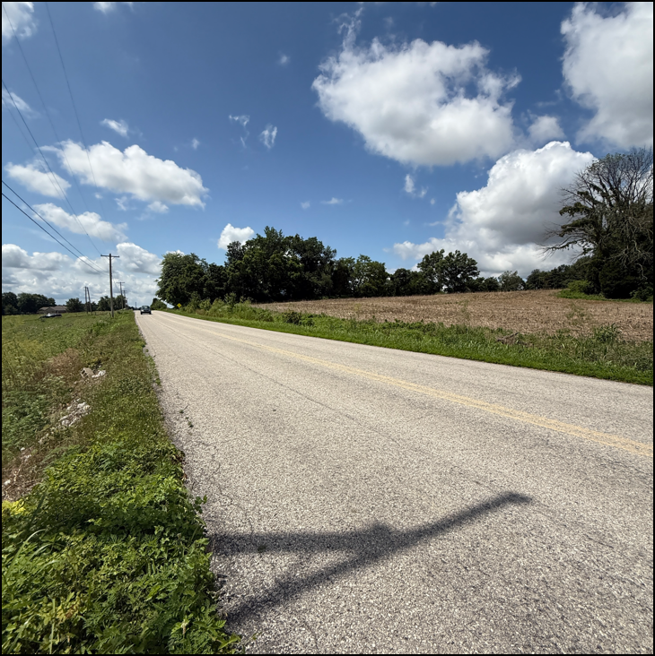
Example 1 - Simple

Slide 6
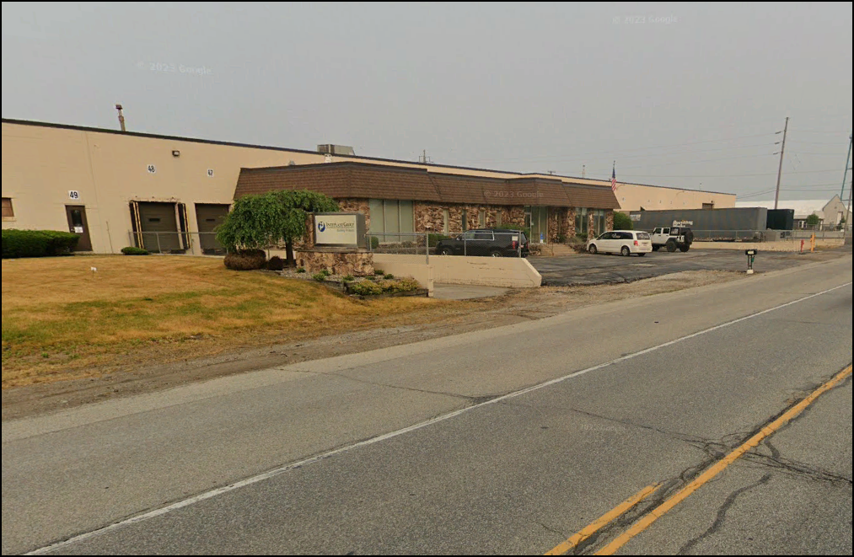
Example 2 - Complex

Slide 7
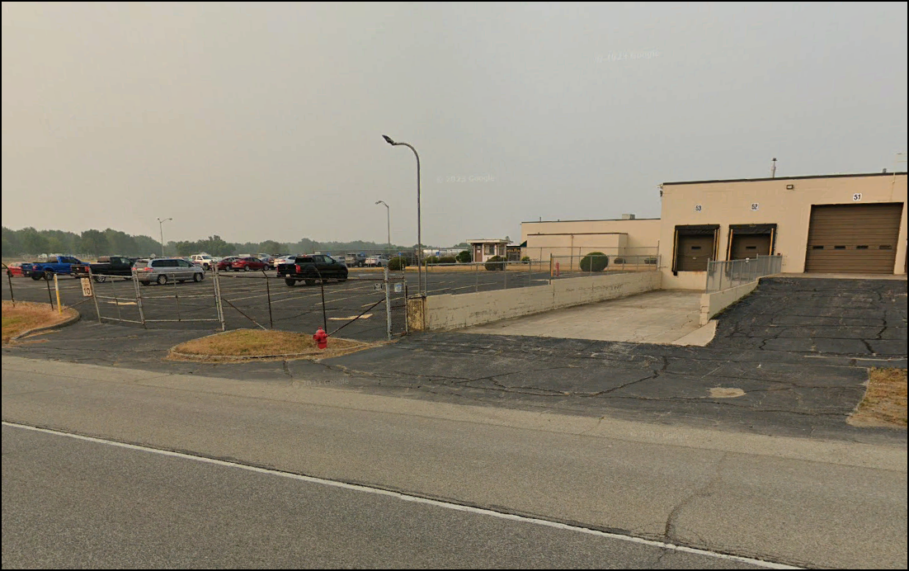
Example 2 - Complex

Slide 8
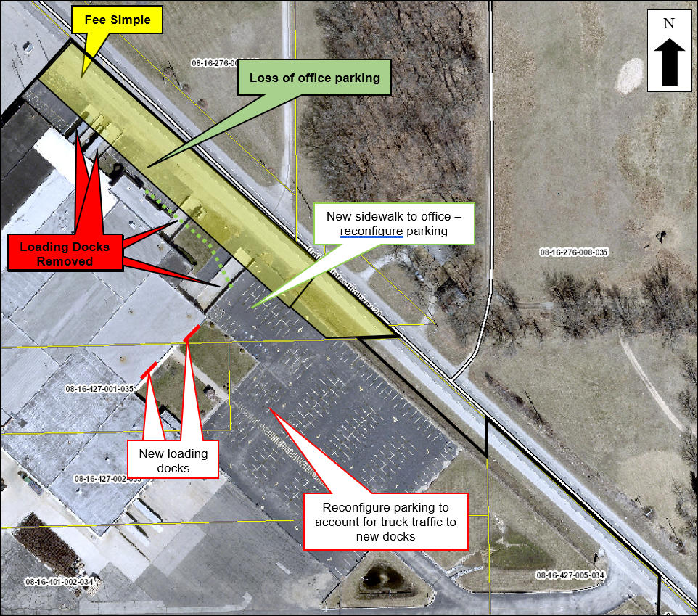
Example 2 - Complex

Slide 9
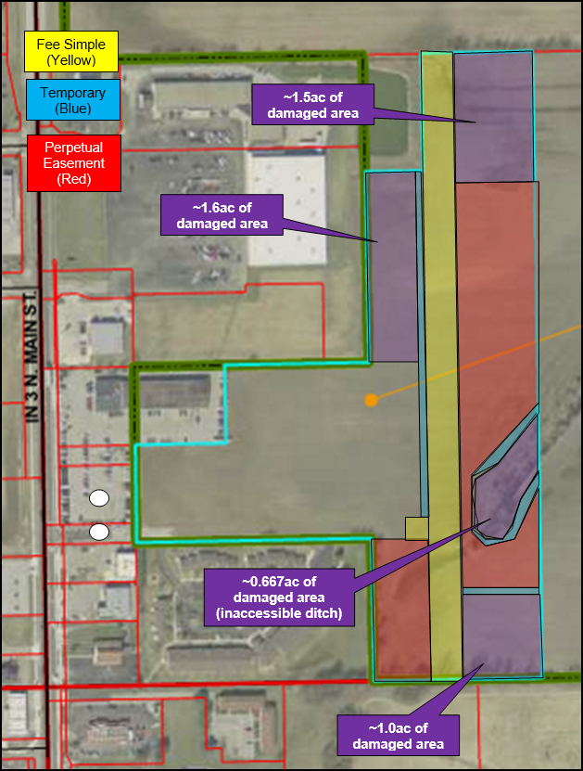
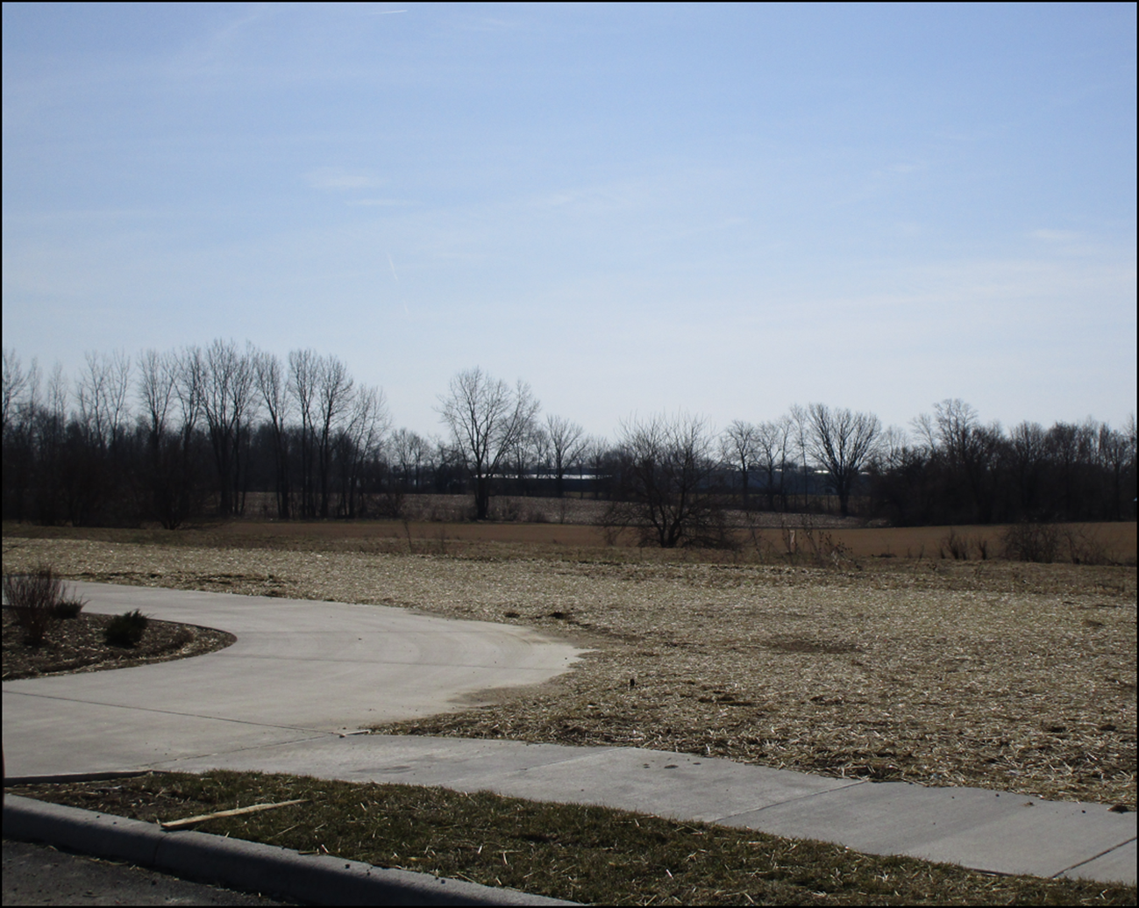
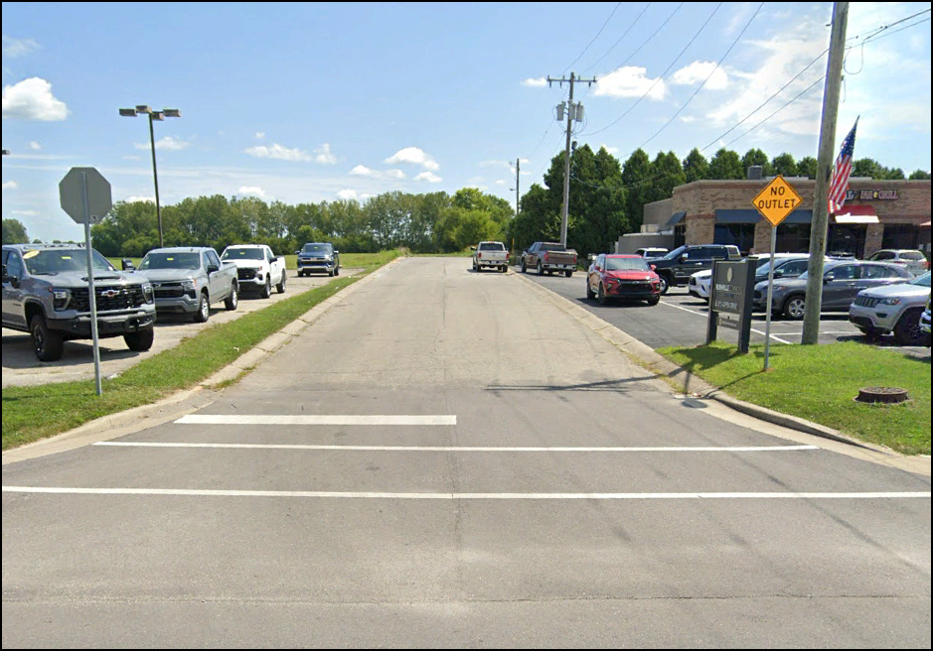
Example 3 - Complex

Slide 10
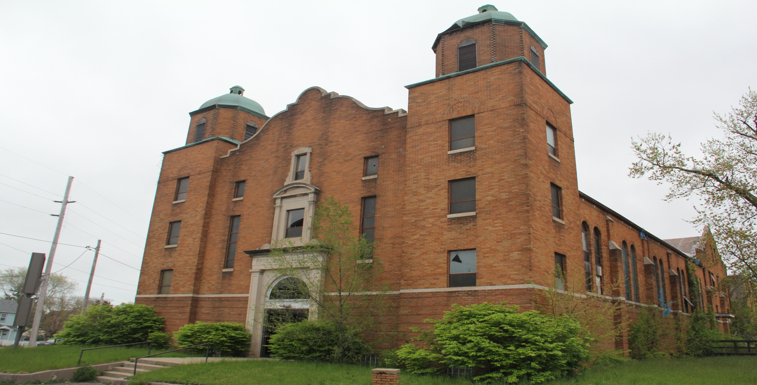
Example 4 - Complex

Slide 11
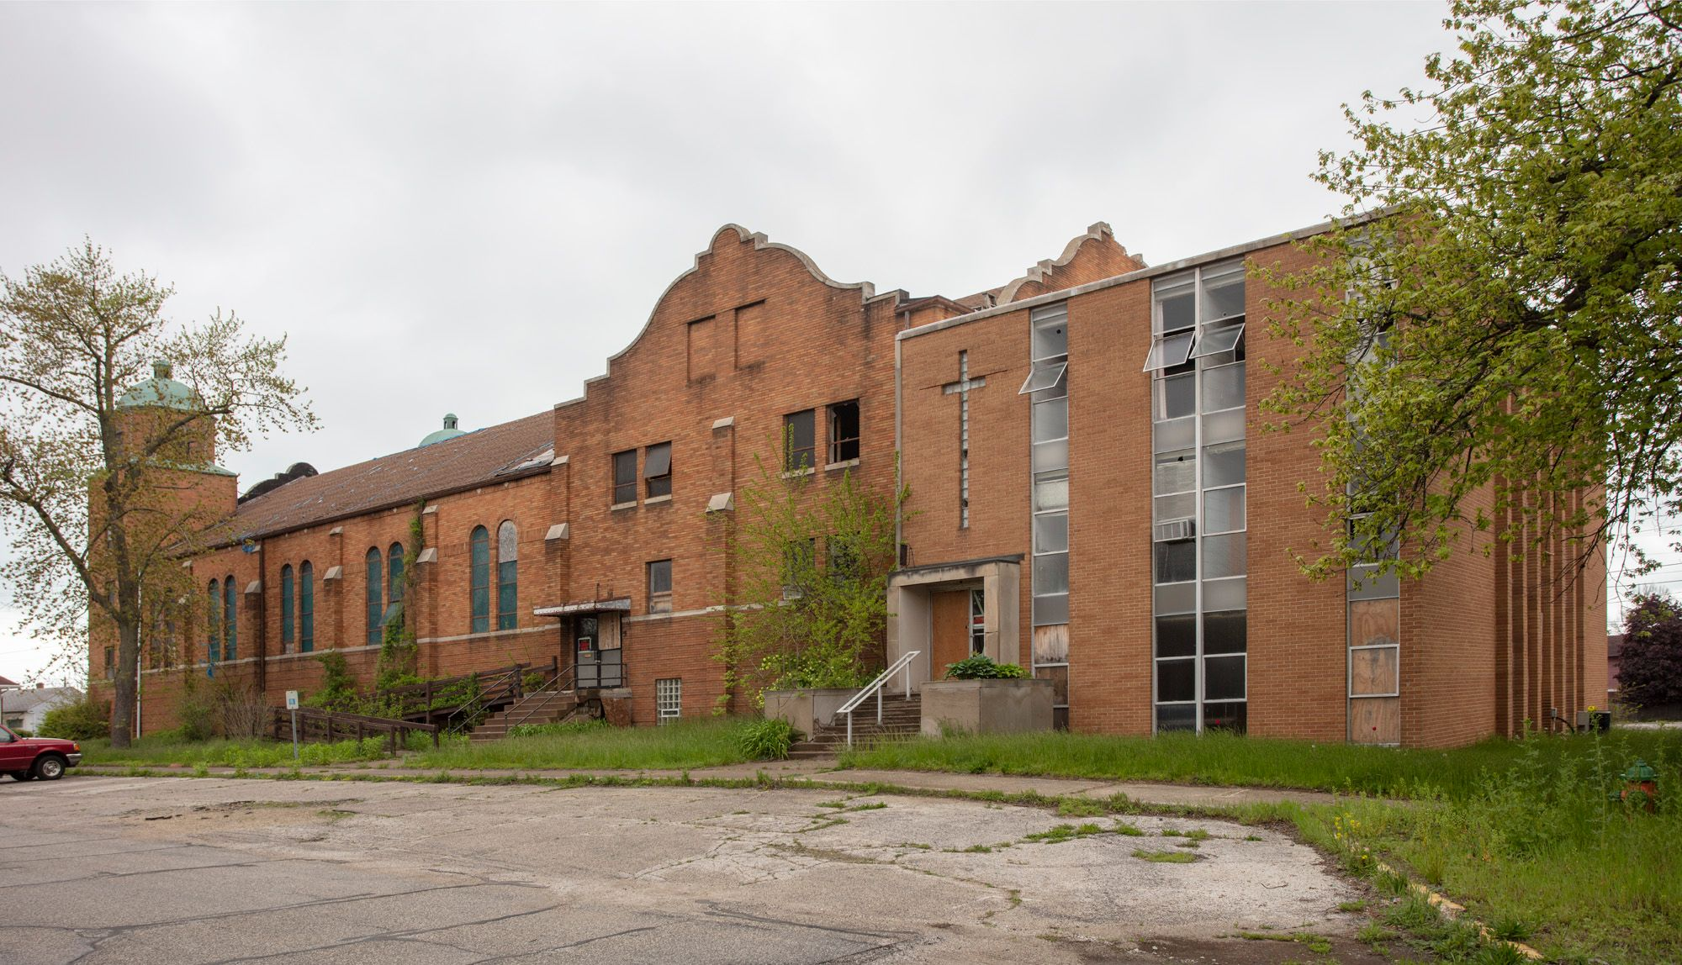

Slide 12
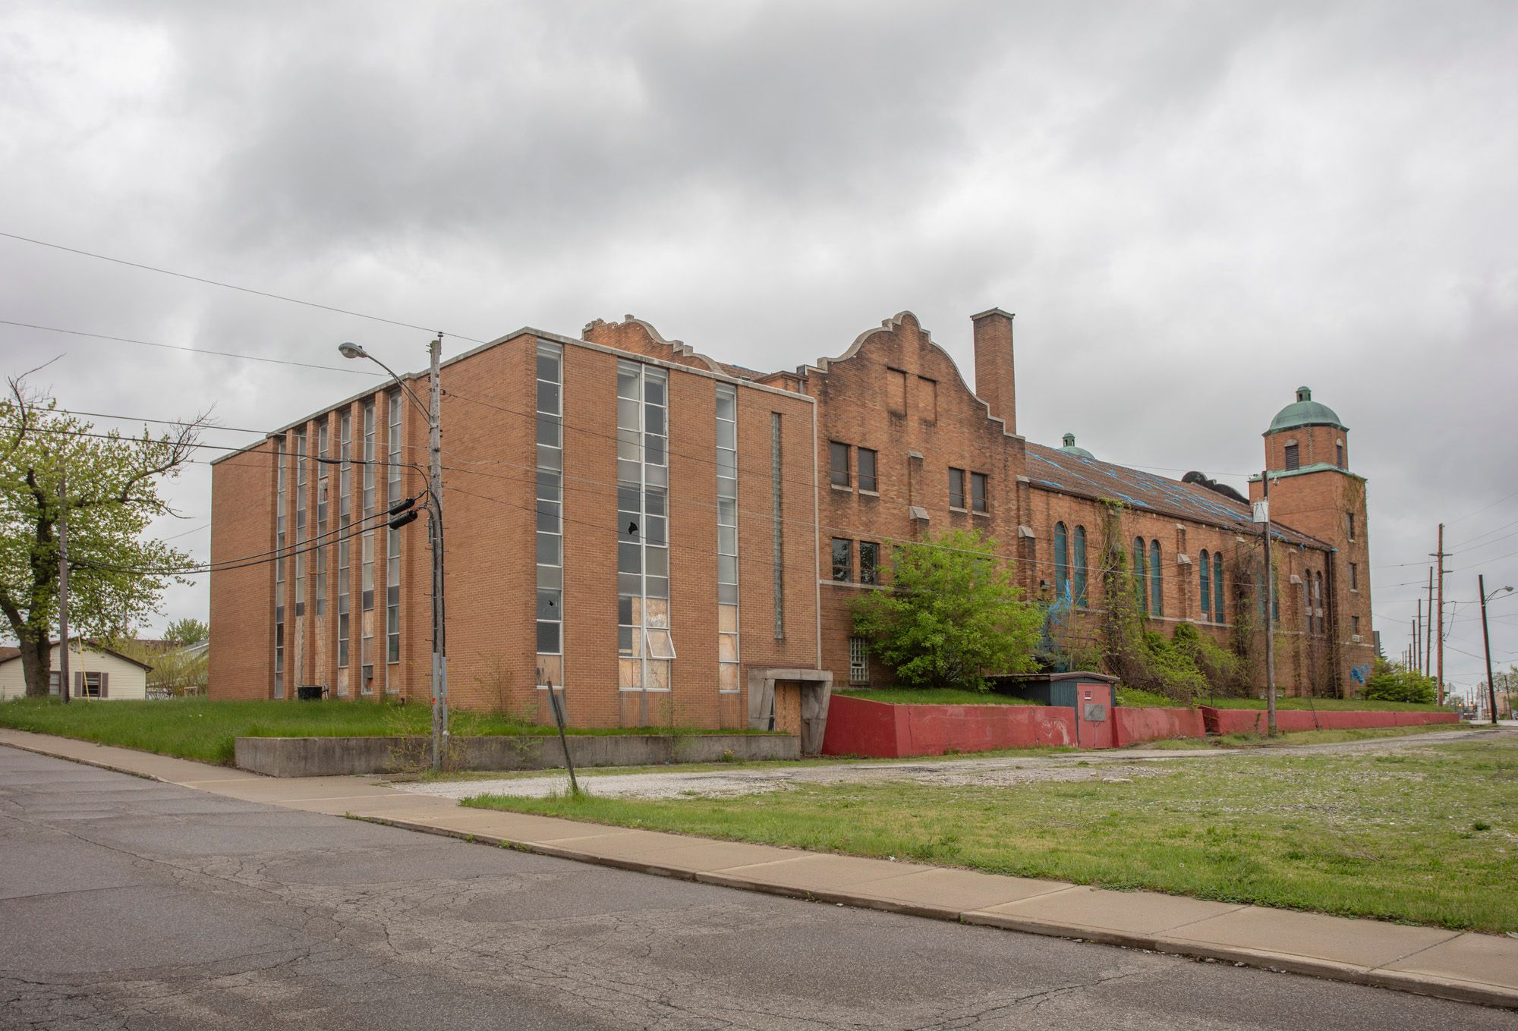

Slide 13
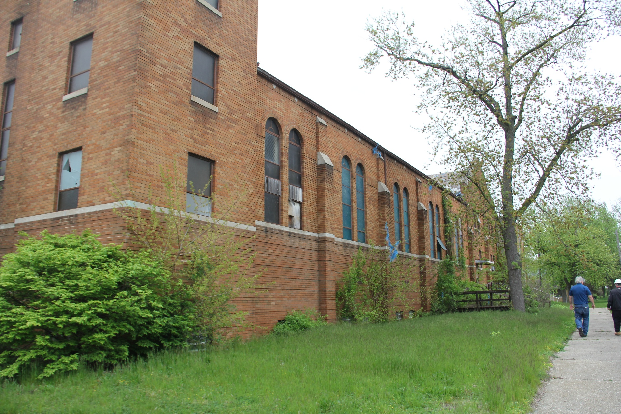

Slide 14
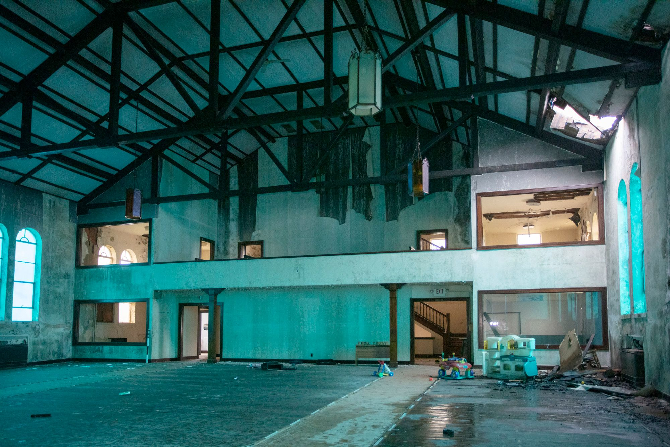

Slide 15
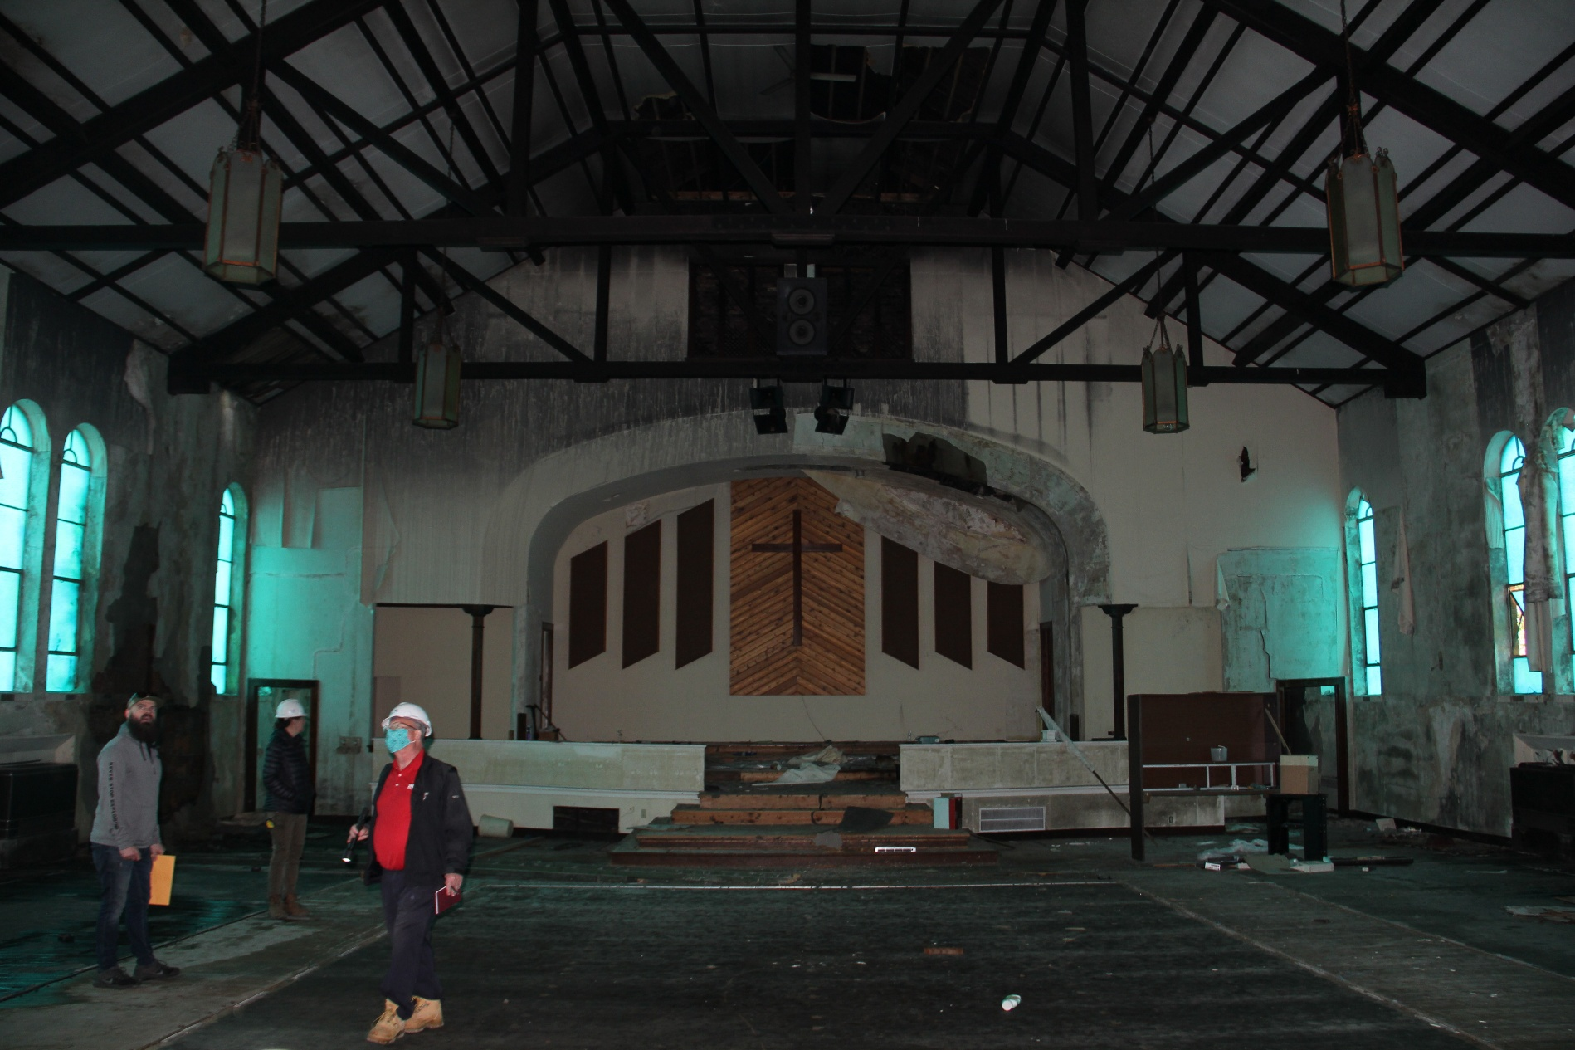

Slide 16
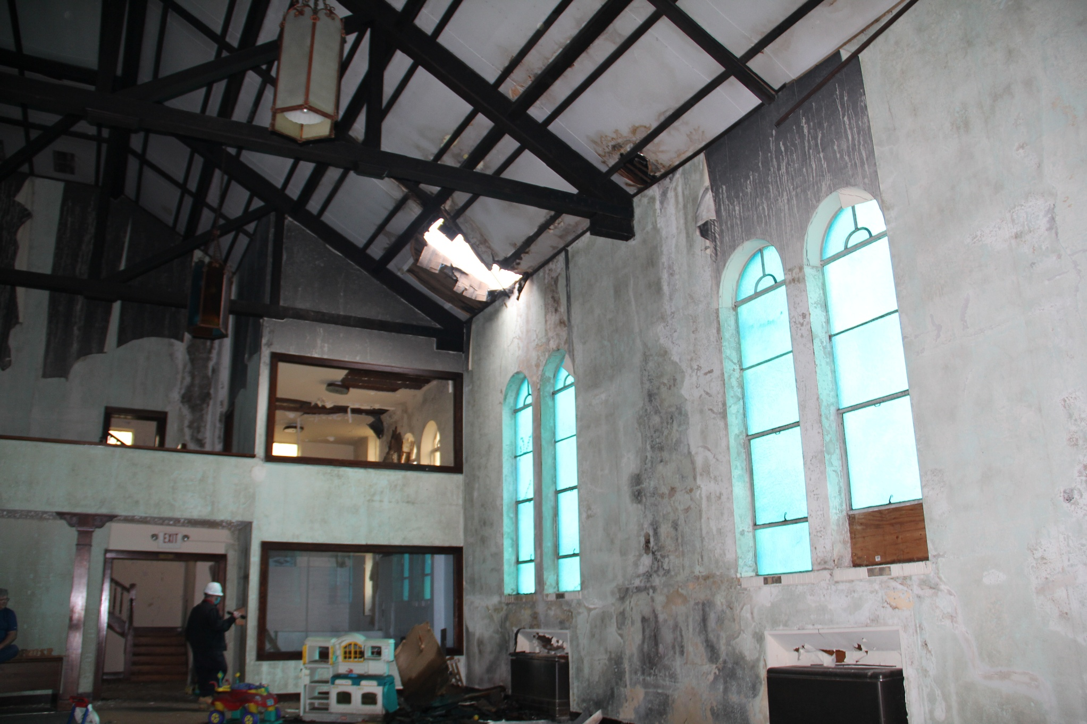

Slide 17
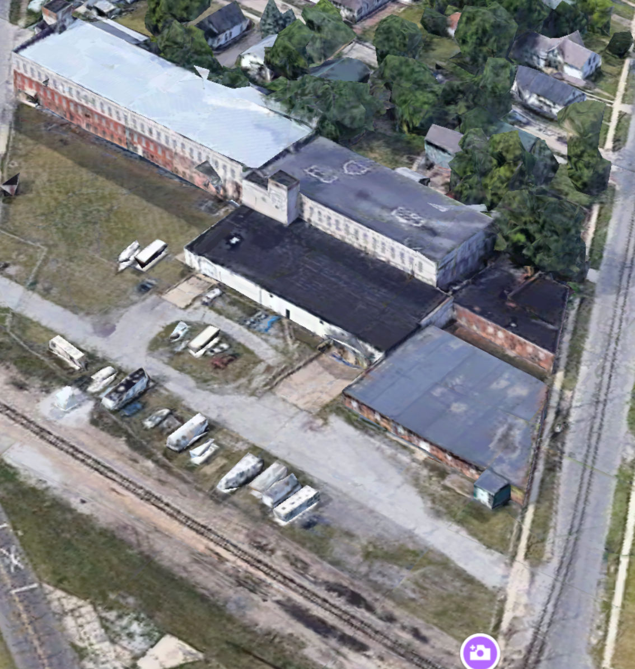
Example 5 - Complex

Slide 19
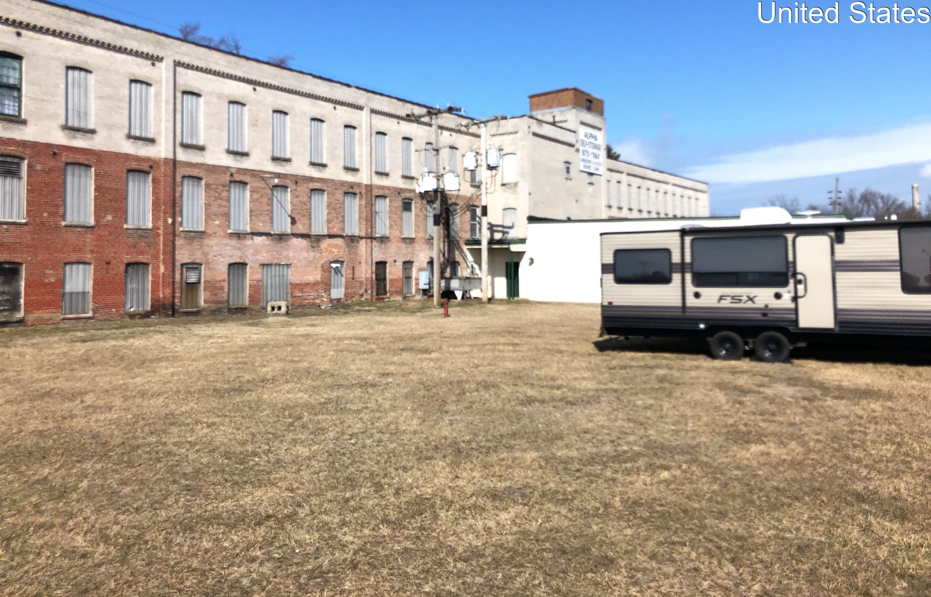

Slide 20
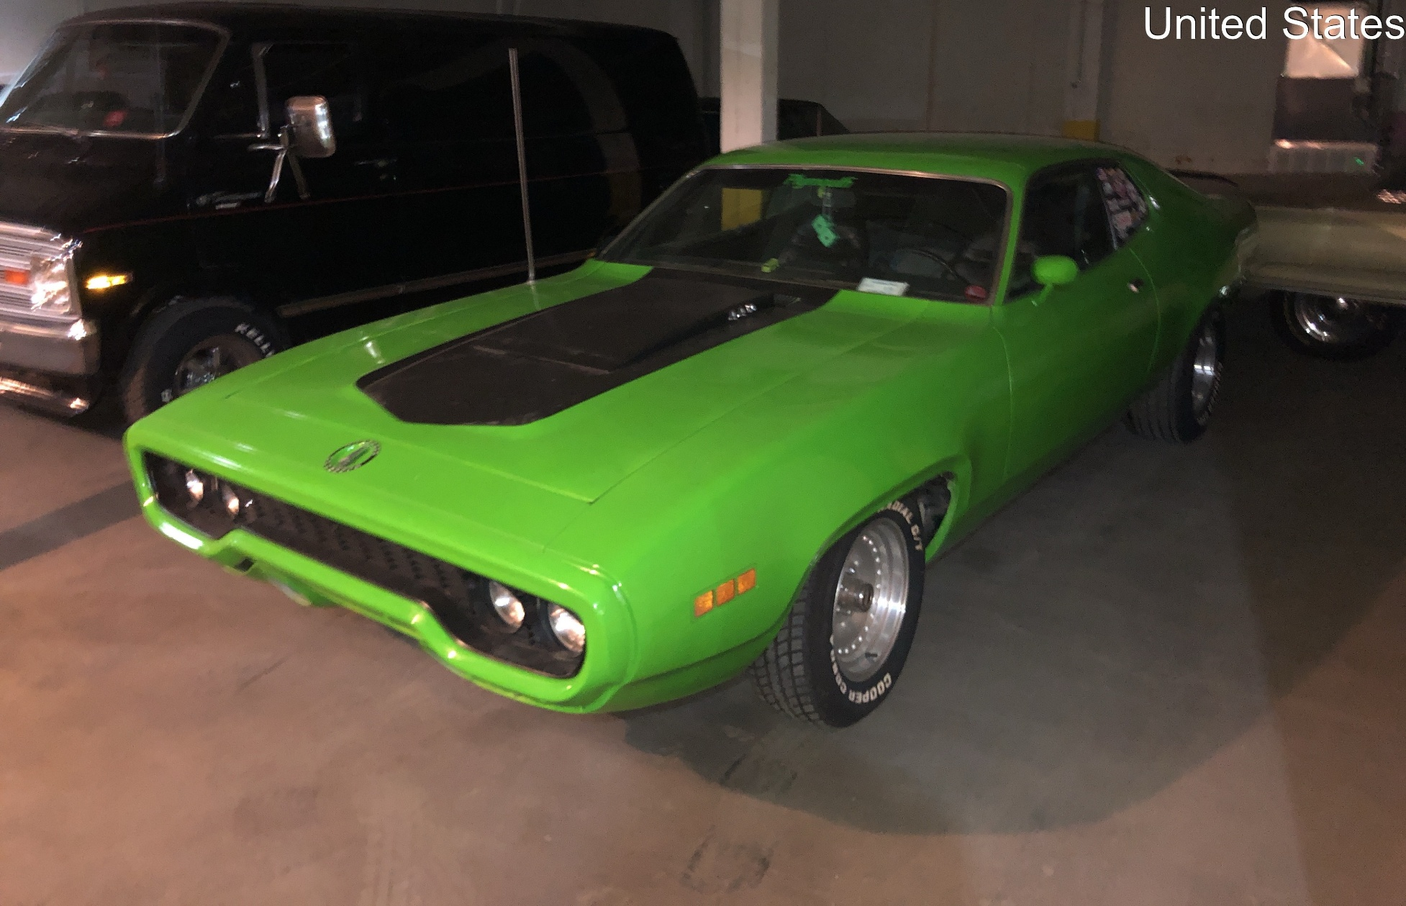

Slide 21
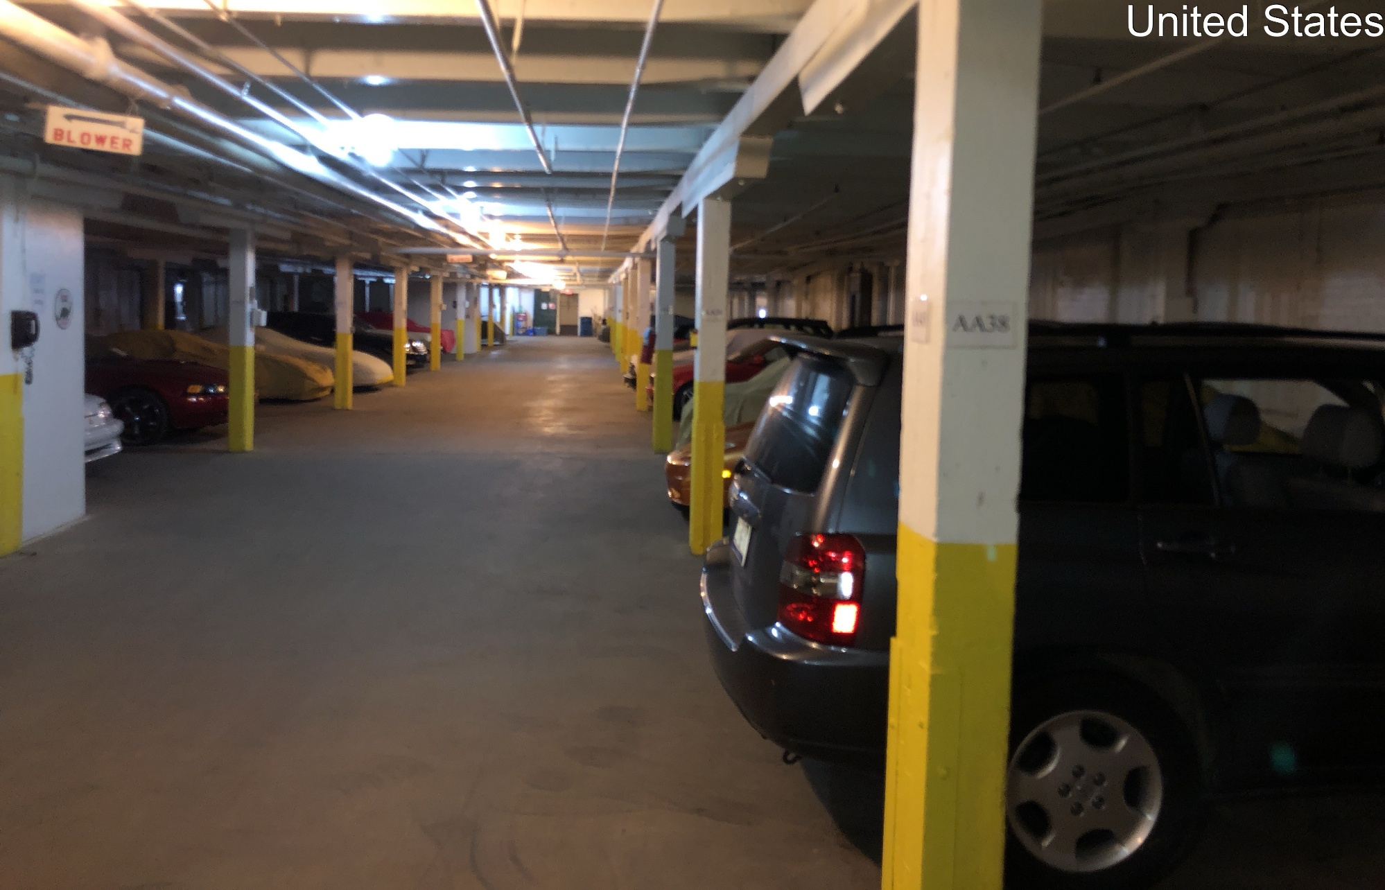

Slide 22
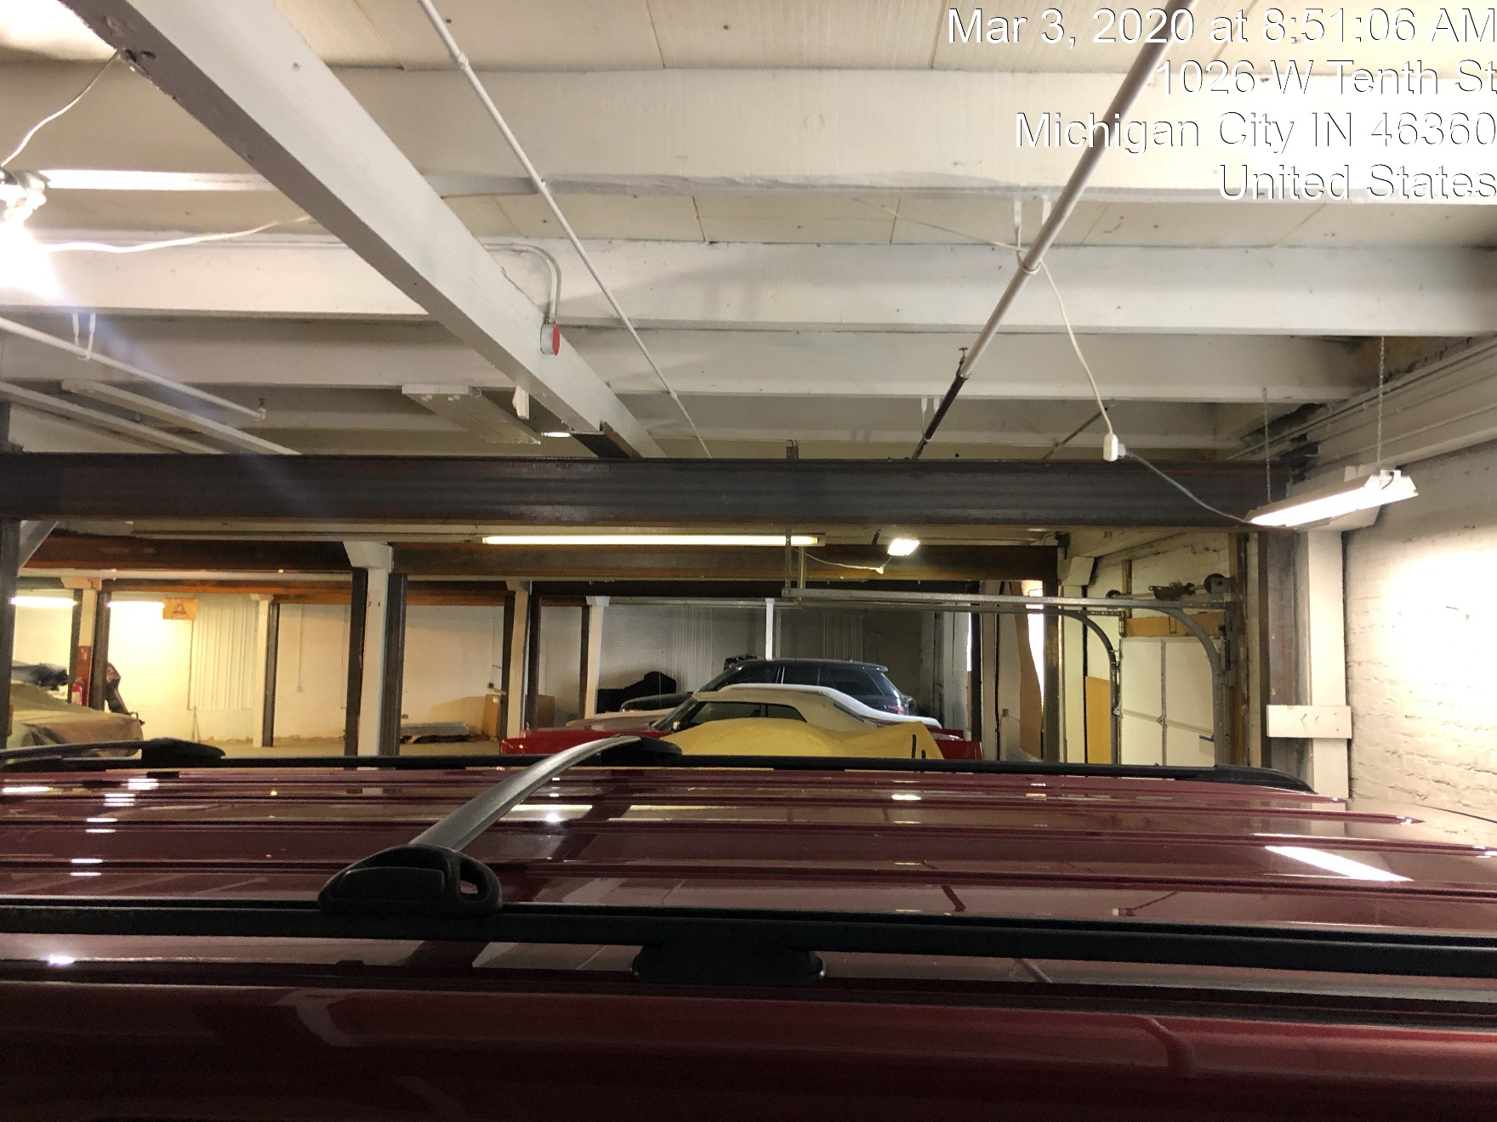

Slide 23
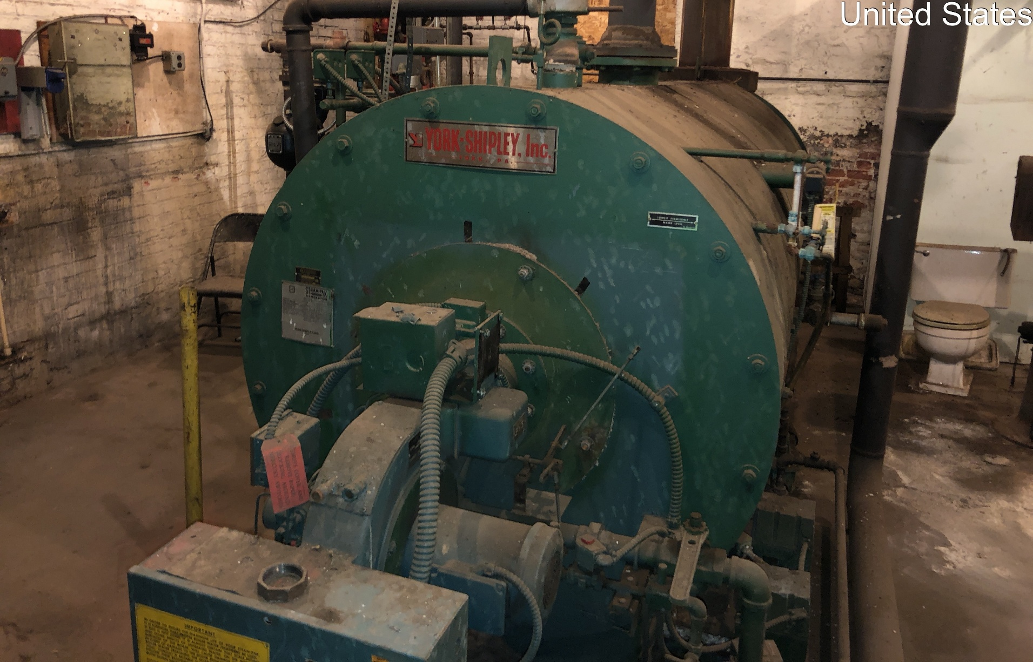

Slide 24
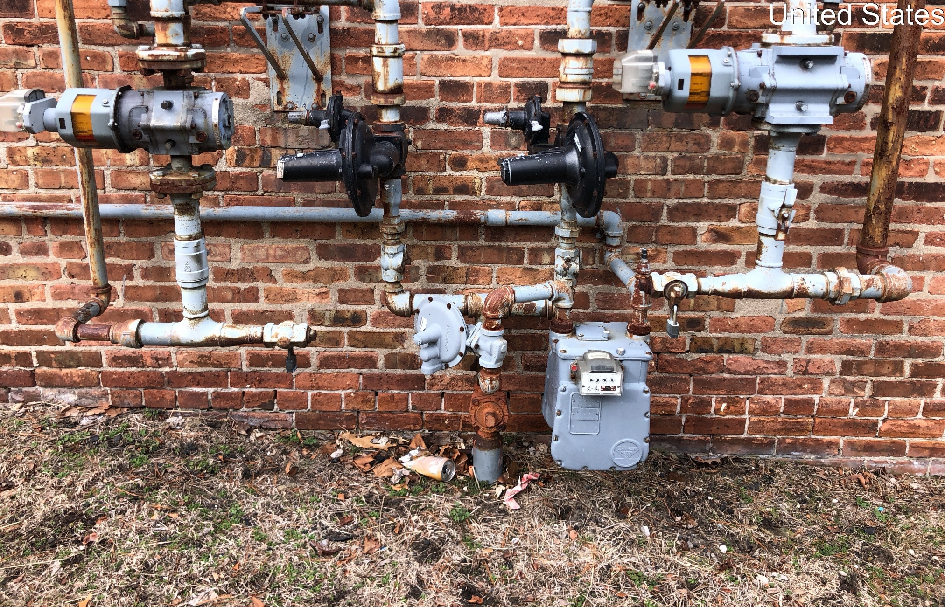

Slide 25
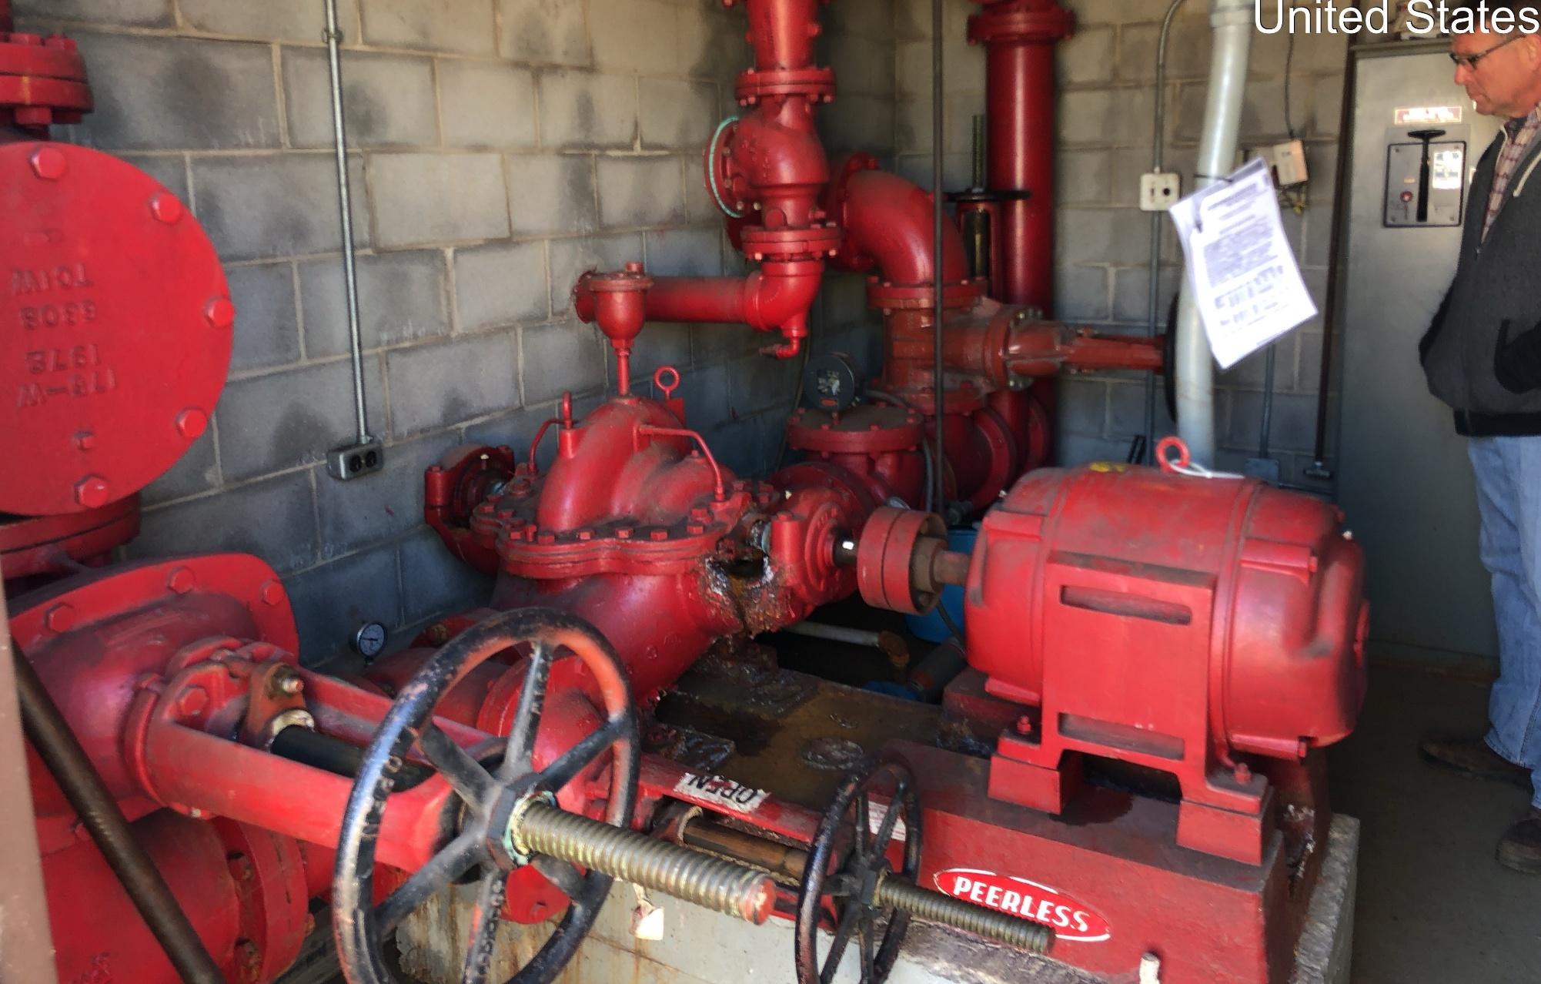

Slide 26
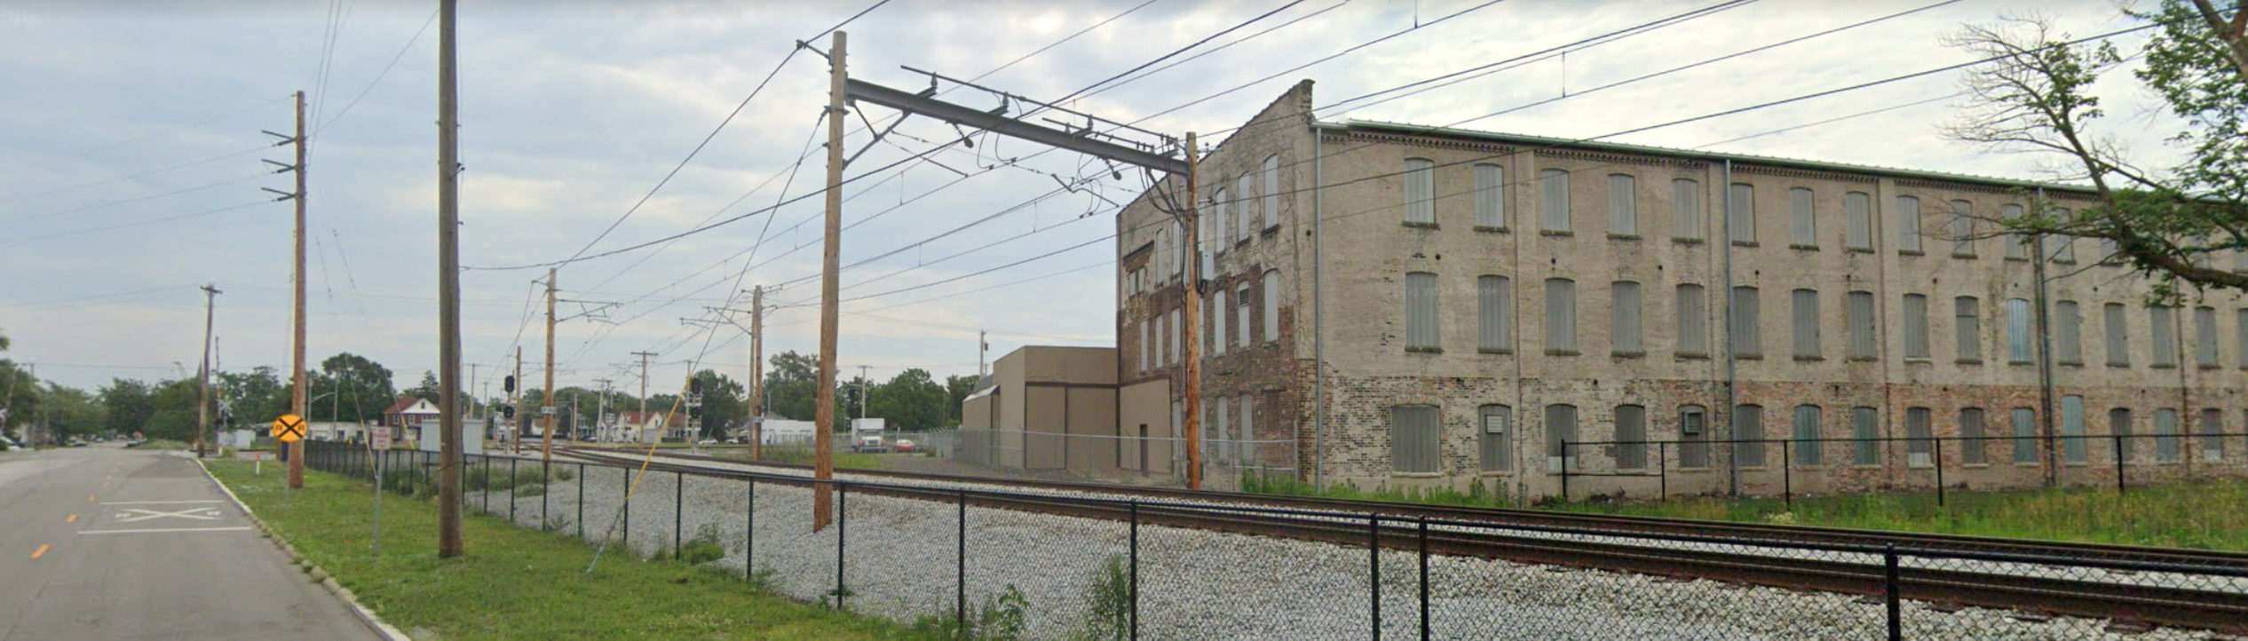

Slide 27
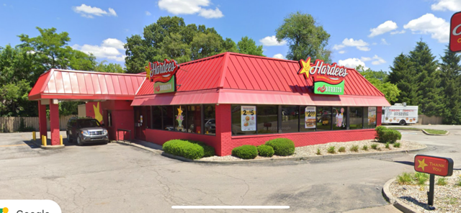
Example 6 - Complex

Slide 28
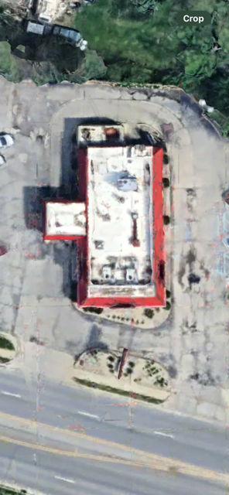

Slide 29
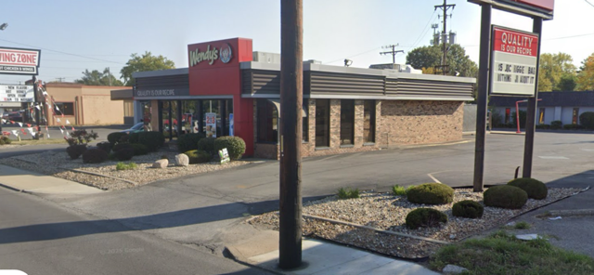

Slide 30
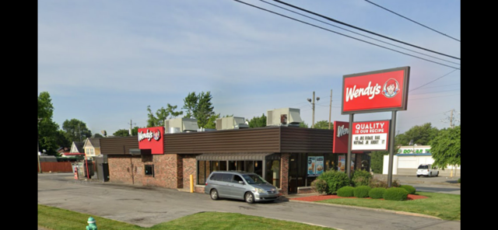

Slide 31
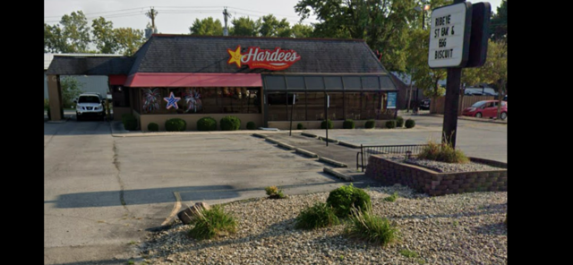

Slide 32
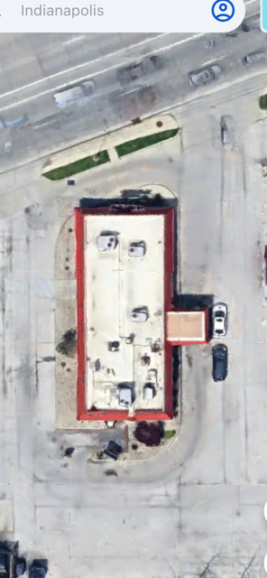

Slide 33
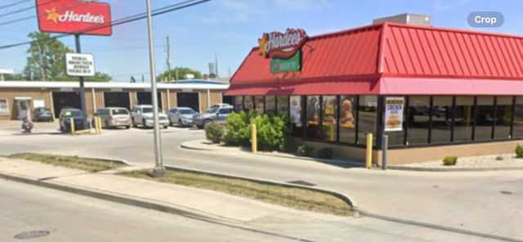

Slide 34
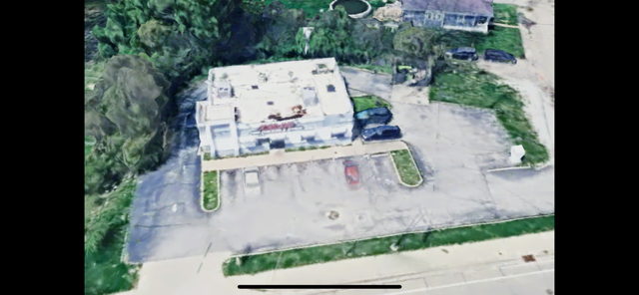

Slide 35
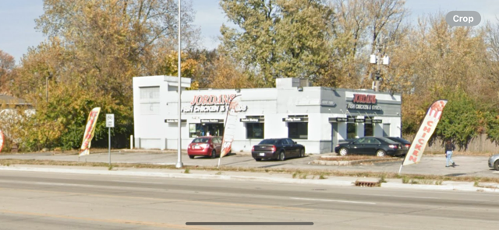

Slide 36


Thank you for attending “Appraising the Tough Ones”!
Presented by

